Slide 1

Online Education
Advantage or Disadvantage of Online Education
This Photo by Unknown Author is licensed under CC BY-SA-NC

Slide 2
CONTENT
INTRODUCTION
GRAPH
ADVANTAGE AND DISADVANTAGE
IMPORTANCE OF ONLINE EDUCATION
ONLINE AND OFFLINE EDUCATION, WHICH ONE IS BETTER
EVOULATION OF ONLINE EDUCATION
QUERY
THANK YOU

Slide 3

What is Online Education
Online education is a procedure of gaining skills and knowledge through electronic devices like computers, mobiles, laptops, etc. using the internet. Online education makes it possible for tutors or mentors to reach all the students more flexibly and teach them the relevant skills more efficiently.

Slide 4
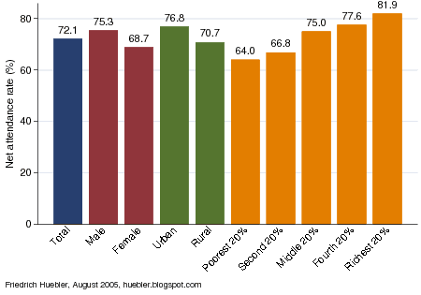
Graph of Online Education

Slide 5
ADVANTAGE AND DISADVANTAGE OF ONLINE EDUCATION
ADVANTAGE
Flexibility. ...
Reduced Costs. ...
More Free Time. ...
Increased Course Variety. ...
Career Advancement Opportunities. ...
Increased Collaboration. ...
Personalized Education. ...
Enhanced Time Management Skills.
DISADVANTAGE
Limited Teacher to Student Feedback
Risk of Social Isolation
Cheating is more brutal to monitor
E-learning is inaccessible to digitally illiterate people
Issues with Accreditation and Quality Assurance
Requires self-motivation and efficient time management skills
The Practical Component of learning suffers
Limited to specific disciplines only

Slide 6
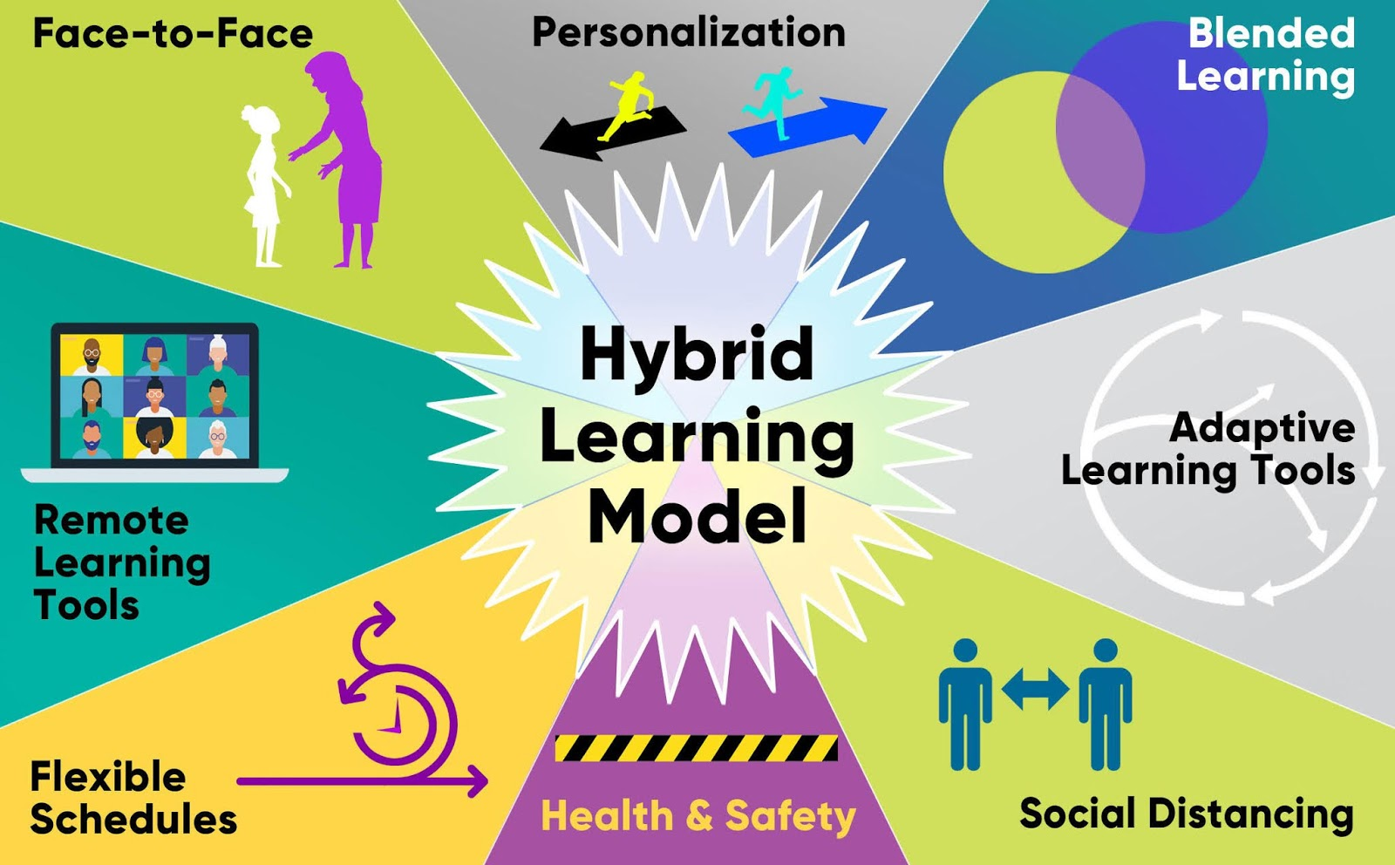
IMPORTANCE OF ONLINE EDUCATION
students need to balance work and school, or simply don't want to commit to a full-time deprogram that requires their physical presence at the university campus. An online program allows stunts to juggle between school and work while also leaving space for them to grow professionally.
This Photo by Unknown Author is licensed under CC BY

Slide 7
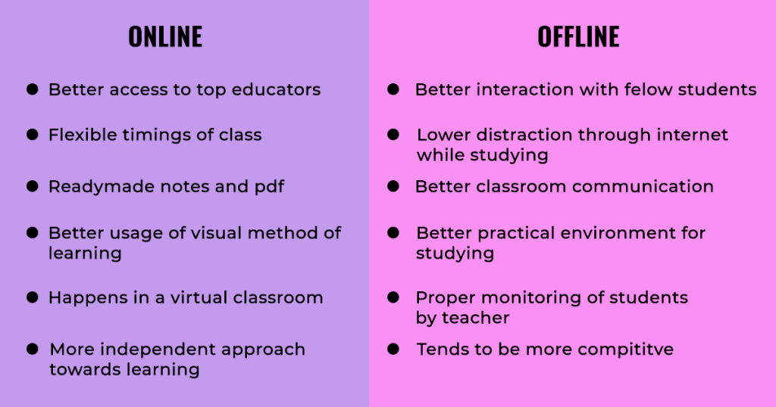
ONLINE EDUCATION AND OFFLINE EDUCATION,WHICH ONE IS BETTER

Slide 8
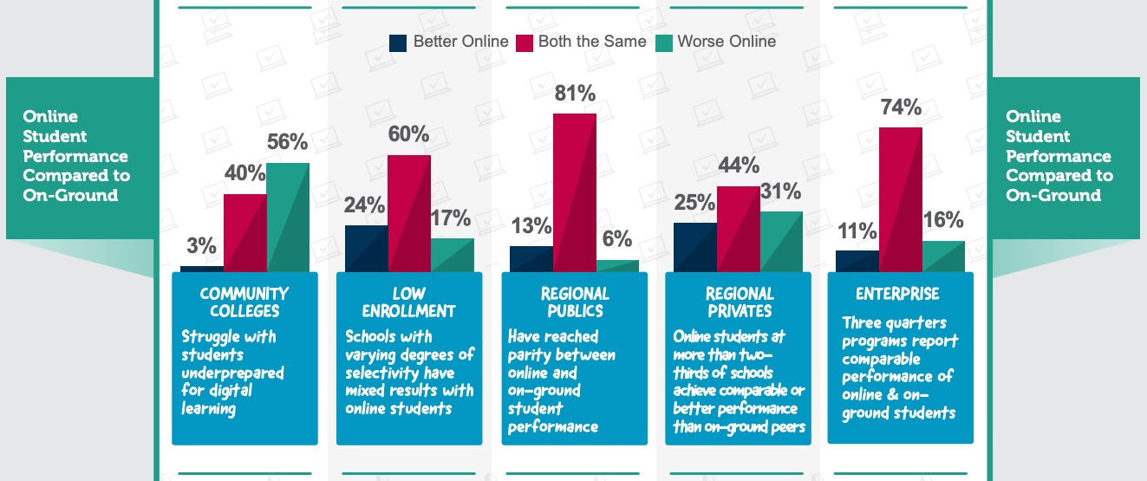
EVOULATION OF ONLINE EDUCATION

Slide 9
QUERY ?

Slide 10
THANK YOU

